Slide 1
Calories Burnt Prediction

Slide 2
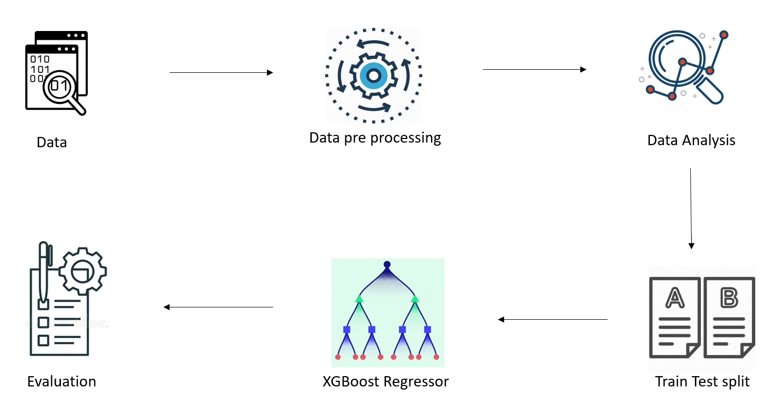
WORK FLOW

Slide 3
DATA DISCRIPTION
User_ID
Gender
Age
Height
Weight
Duration
Heart_Rate
Body_Temp
User_ID
Calories
Calories Dataset
Exercise Dataset
Colum 15000 Row 9 variables:

Slide 4
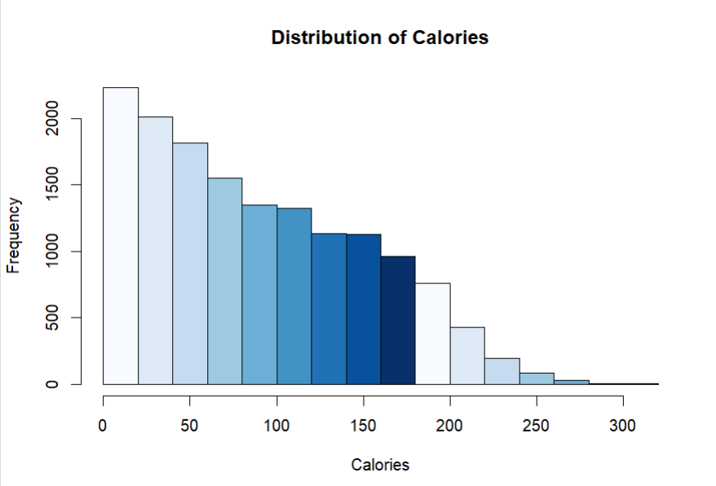

Slide 5
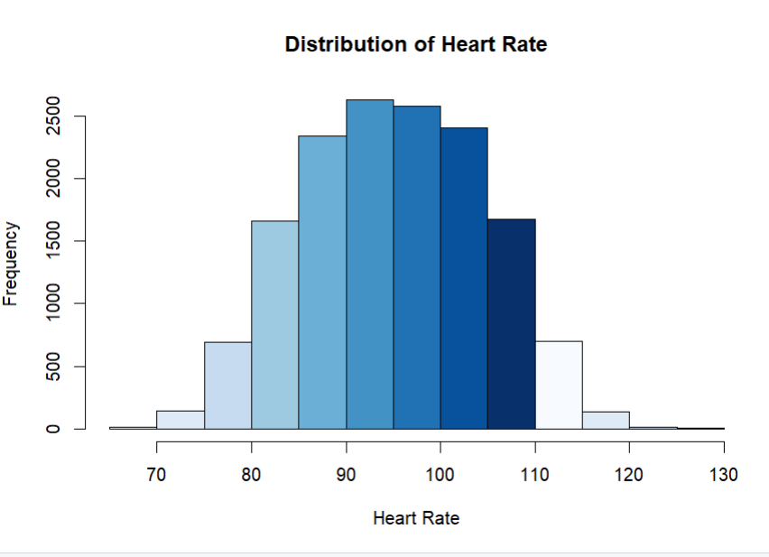

Slide 6
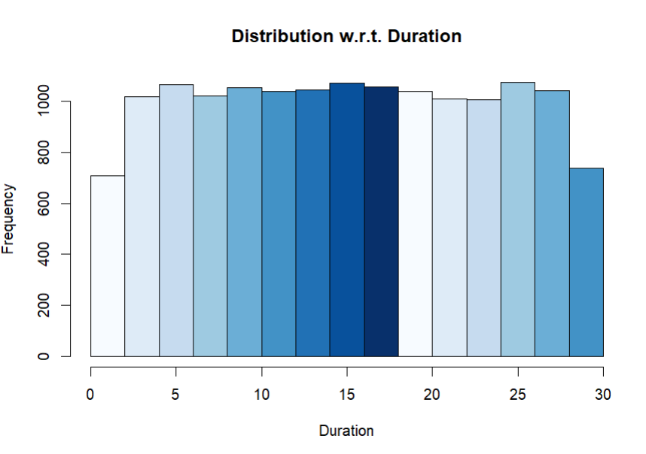

Slide 7
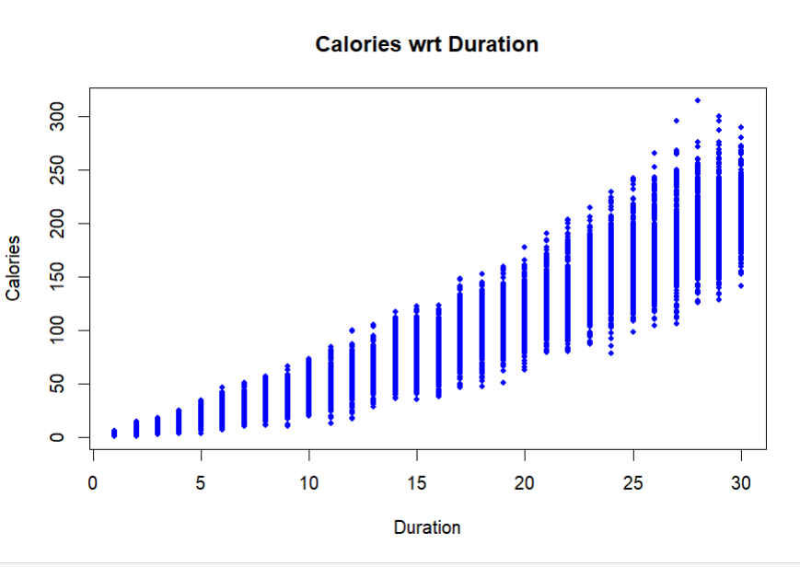

Slide 8
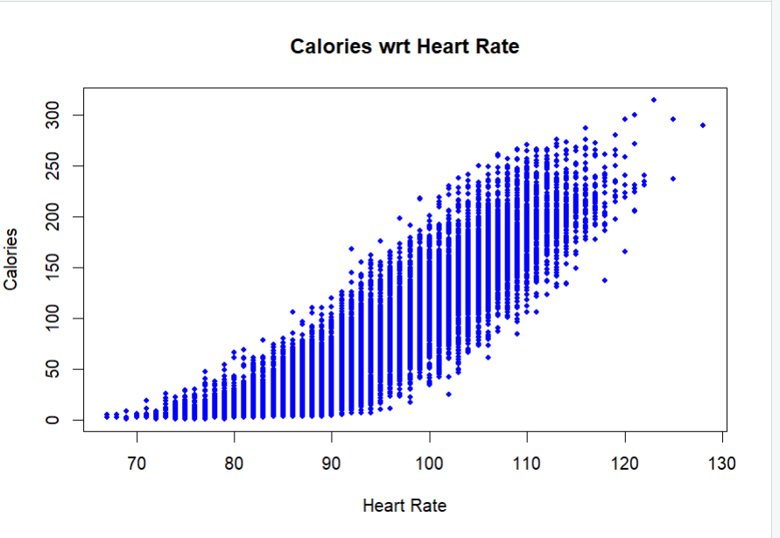

Slide 9
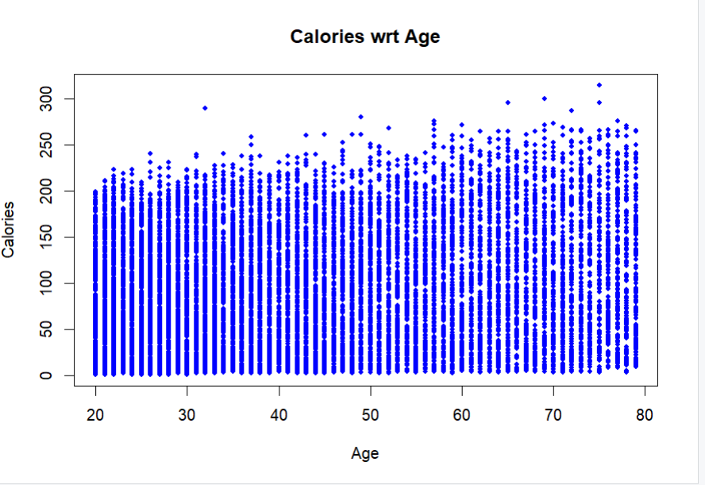

Slide 10
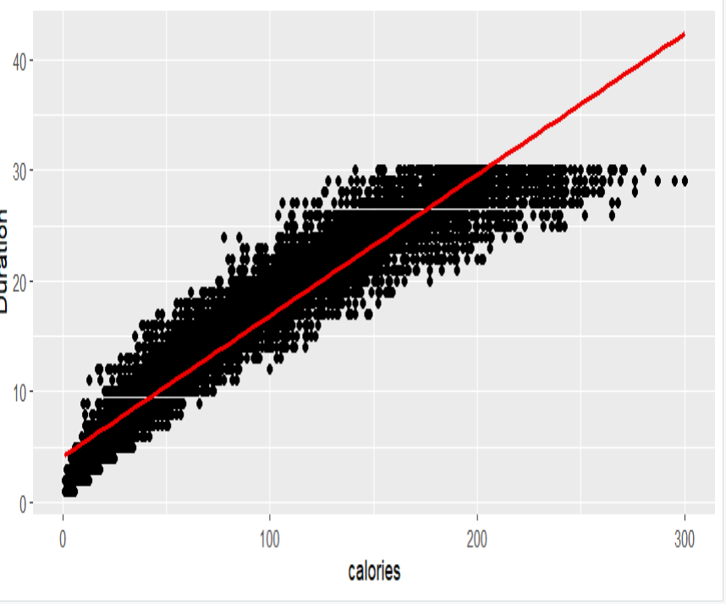
MODEL BUILDING
SimpleLinearRegression
Accuracy -->91
Residual standard error: 18.28

Slide 11
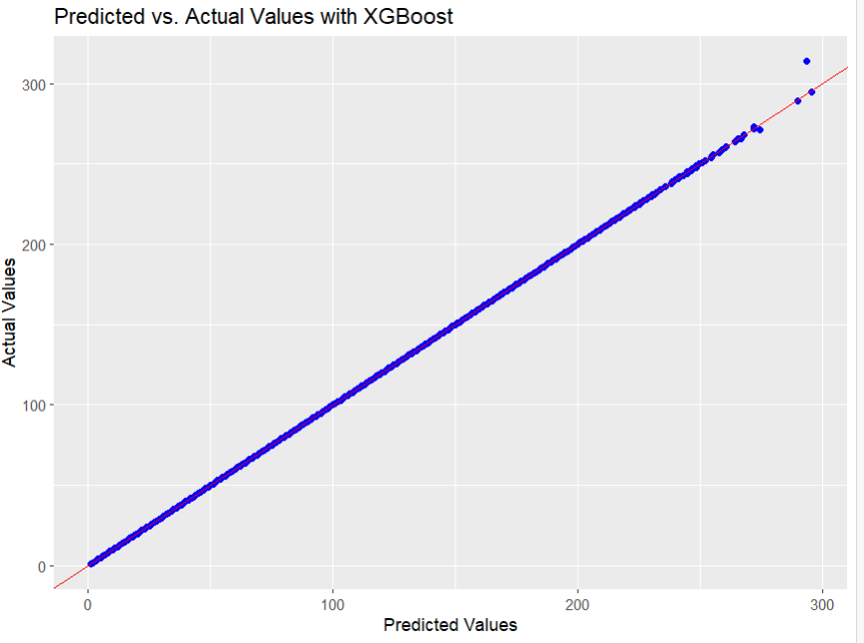
MODEL BUILDING
XGBoost
Accuracy -->96
Residual standard error: 0.31

Slide 12

THANK YOU

